Slide 1
Natural Language Visualization with Scattertext
Jason S. Kessler*
Global AI Conference
April 27, 2018
Code for all visualizations is available at:
https://github.com/JasonKessler/GlobalAI2018
$ pip3 install scattertext
*No, not that Jason Kessler
@jasonkessler

Slide 2
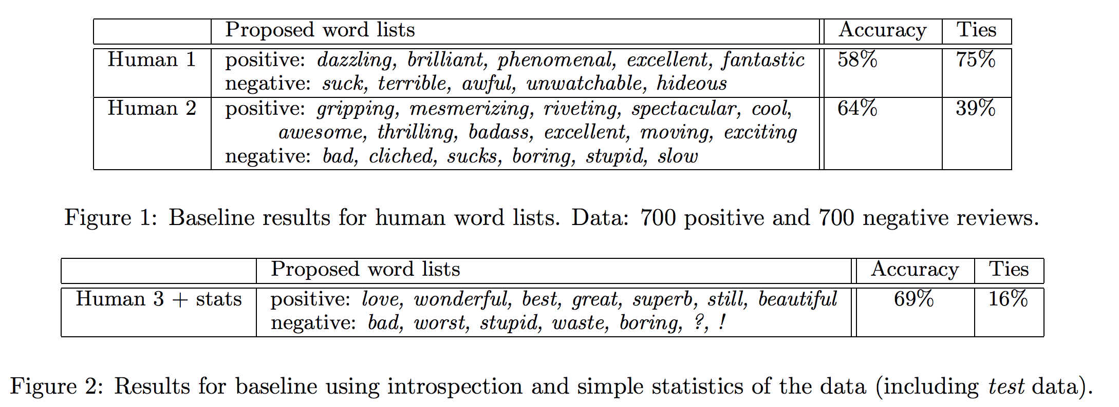
Lexicon speculation
Bo Pang, Lillian Lee and Shivakumar Vaithyanathan. Thumbs up? Sentiment classification using machine learning techniques. EMNLP. 2002. (ACL 2018 Test of Time Award Winner)
@jasonkessler

Slide 3
Lexicon mining ≈ lexicon speculation
Bo Pang, Lillian Lee and Shivakumar Vaithyanathan. Thumbs up? Sentiment classification using machine learning techniques. EMNLP. 2002.
@jasonkessler

Slide 4
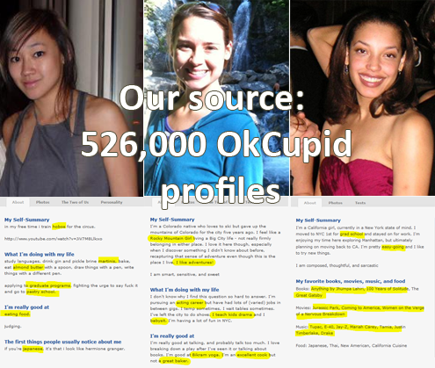
Language and Demographics
hobos
almond
butter
100 Years of
Solitude
Bikram yoga
@jasonkessler
Christian Rudder: http://blog.okcupid.com/index.php/page/7/
Notes:
Selected termsWhich words and phrases statistically distinguish ethnic groups and genders?

Slide 5
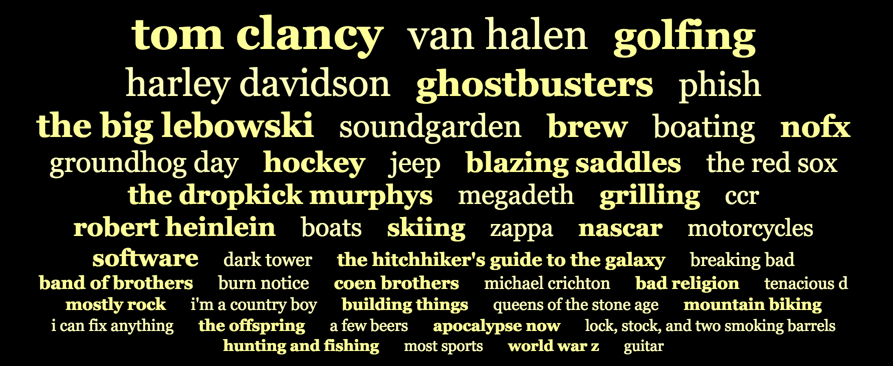
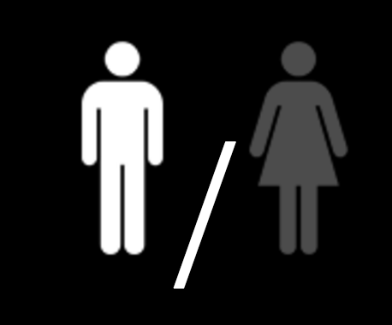
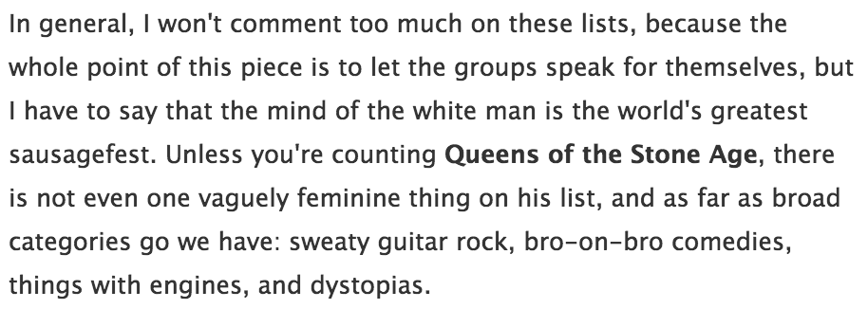
OKCupid: Words and phrases that distinguish white men.
@jasonkessler
Source: http://blog.okcupid.com/index.php/page/7/ (Rudder 2010)

Slide 6
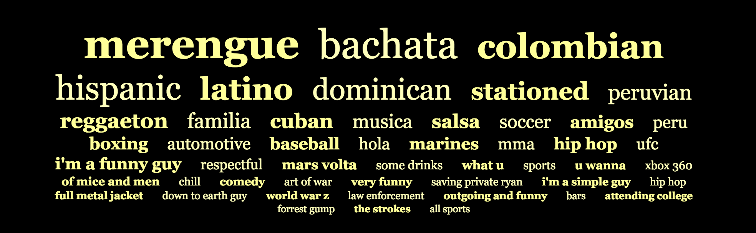
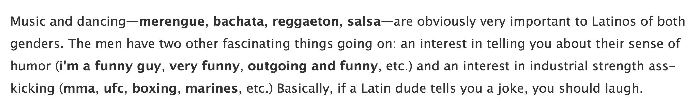
OKCupid: Words and phrases that distinguish Latin men.
Explanation
@jasonkessler
Source: http://blog.okcupid.com/index.php/page/7/ (Rudder 2010)

Slide 7
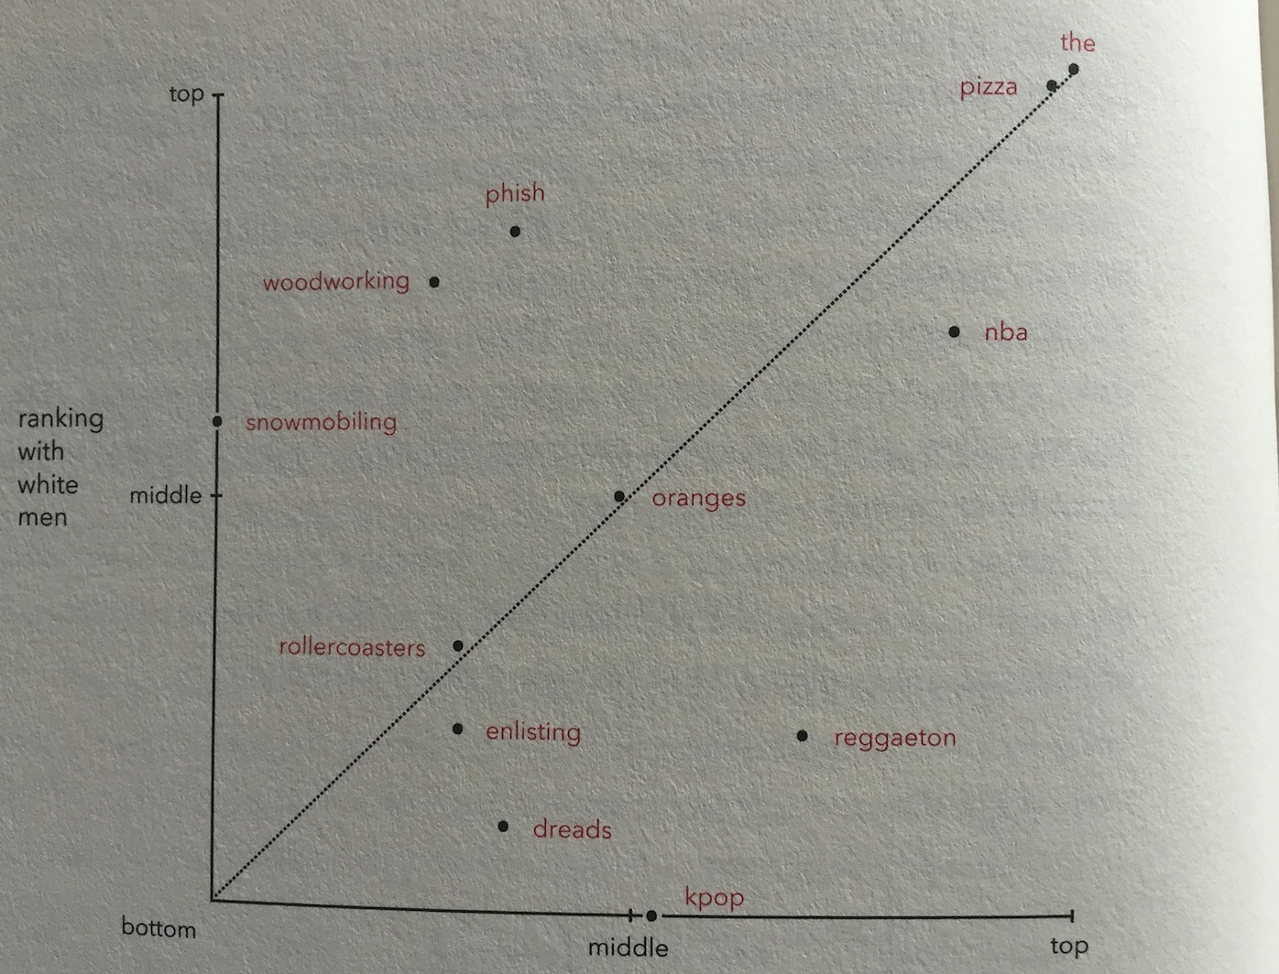
Phish is highly associated with white men
The smaller the distance from the top left, the higher the association with white men
Kpop is not
Source: Christian Rudder. Dataclysm. 2014.
Ranking with everyone else
@jasonkessler

Slide 8
my blue eyes
Source: Christian Rudder. Dataclysm. 2014.
@jasonkessler
Notes:
Selected terms

Slide 9
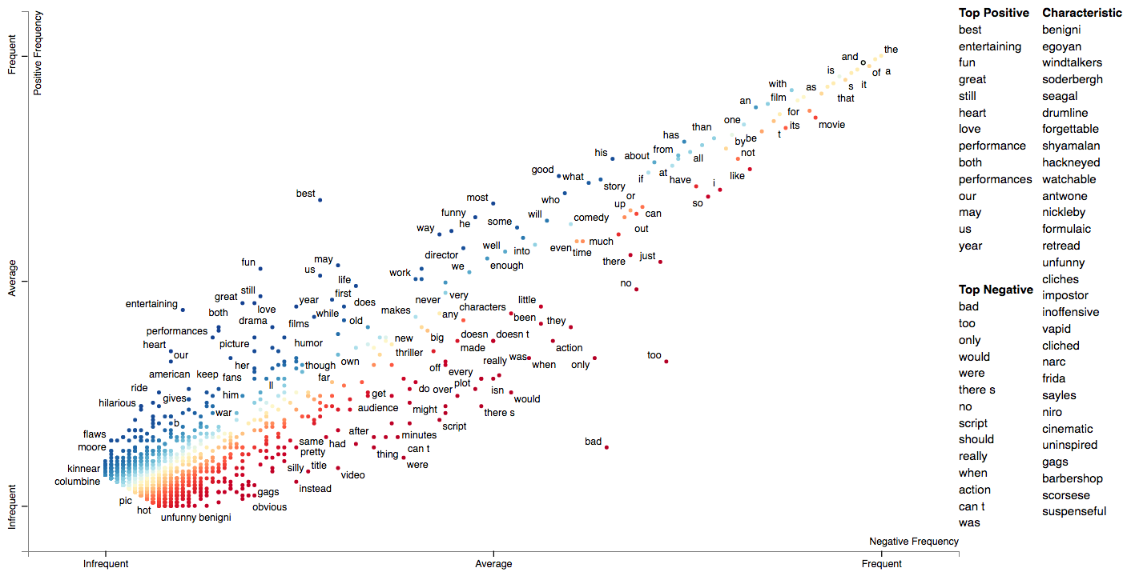
Scattertext
pip install scattertext
github.com/JasonKessler/scattertext
Interactive, d3-based scatterplot
Concise Python API
Automatically displays non-overlapping labels
Jason S. Kessler. Scattertext: a Browser-Based Tool for Visualizing how Corpora Differ. ACL System Demonstrations. 2017.
@jasonkessler
Notes:
Selected terms

Slide 10
Scaled F-Score
Term-class* associations:
“Good” is associated with the “positive” class
“Bad” with the class “negative”
Core intuition: association relies on two necessary factors
Frequency: How often a term occurs in a class
Precision: P(class|document contains term)
F-Score:
Information retrieval evaluation metric
Harmonic mean between precision and recall
Requires both metrics to be high
*Term: is defined to be a word, phrase or other discrete linguistic element
@jasonkessler

Slide 11
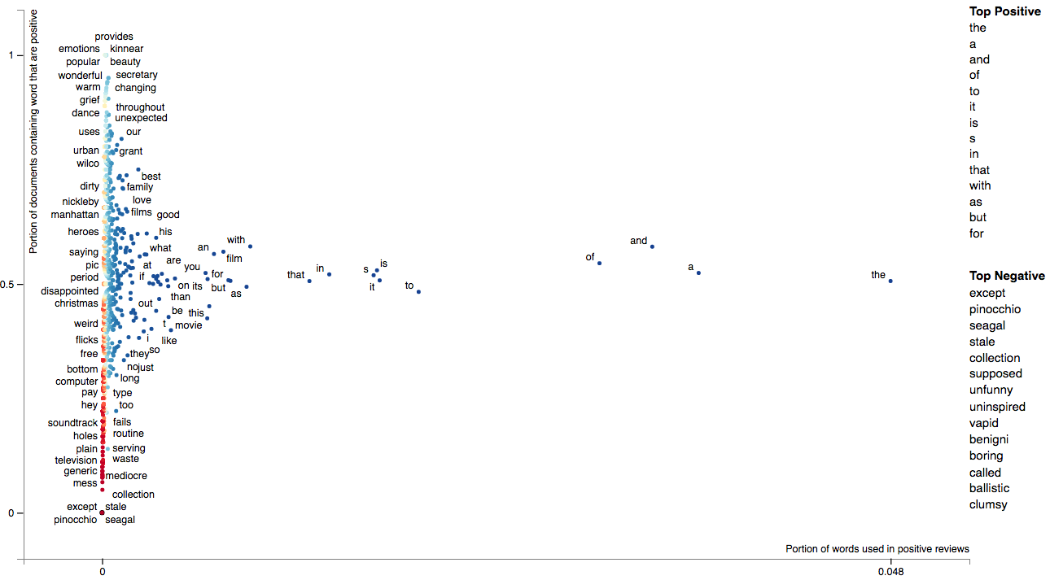
Naïve approach
Precision
Frequency
@jasonkessler

Slide 12
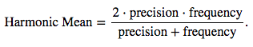
Naïve approach
Y-axis: | Precision, i.e. P(class|term), roughly normal distribution Mean ≅ 0.5, sd ≅ 0.4,
X-axis: | Frequency, i.e. P(term|class), roughly power distribution Mean ≅ 0.00008, sd ≅ 0.008
Color: | Harmonic mean of precision and frequency (blue=high, red=low)
Precision
Frequency
@jasonkessler

Slide 13
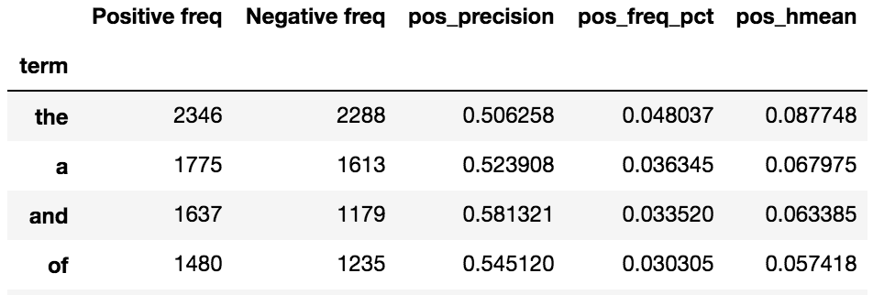
Precision
Problem:
Top words are just stop words.
Why?
Harmonic mean of uneven distributions.
Most words have prec of ~0.5, leads harmonic mean to rely on frequency.
Frequency
@jasonkessler

Slide 14
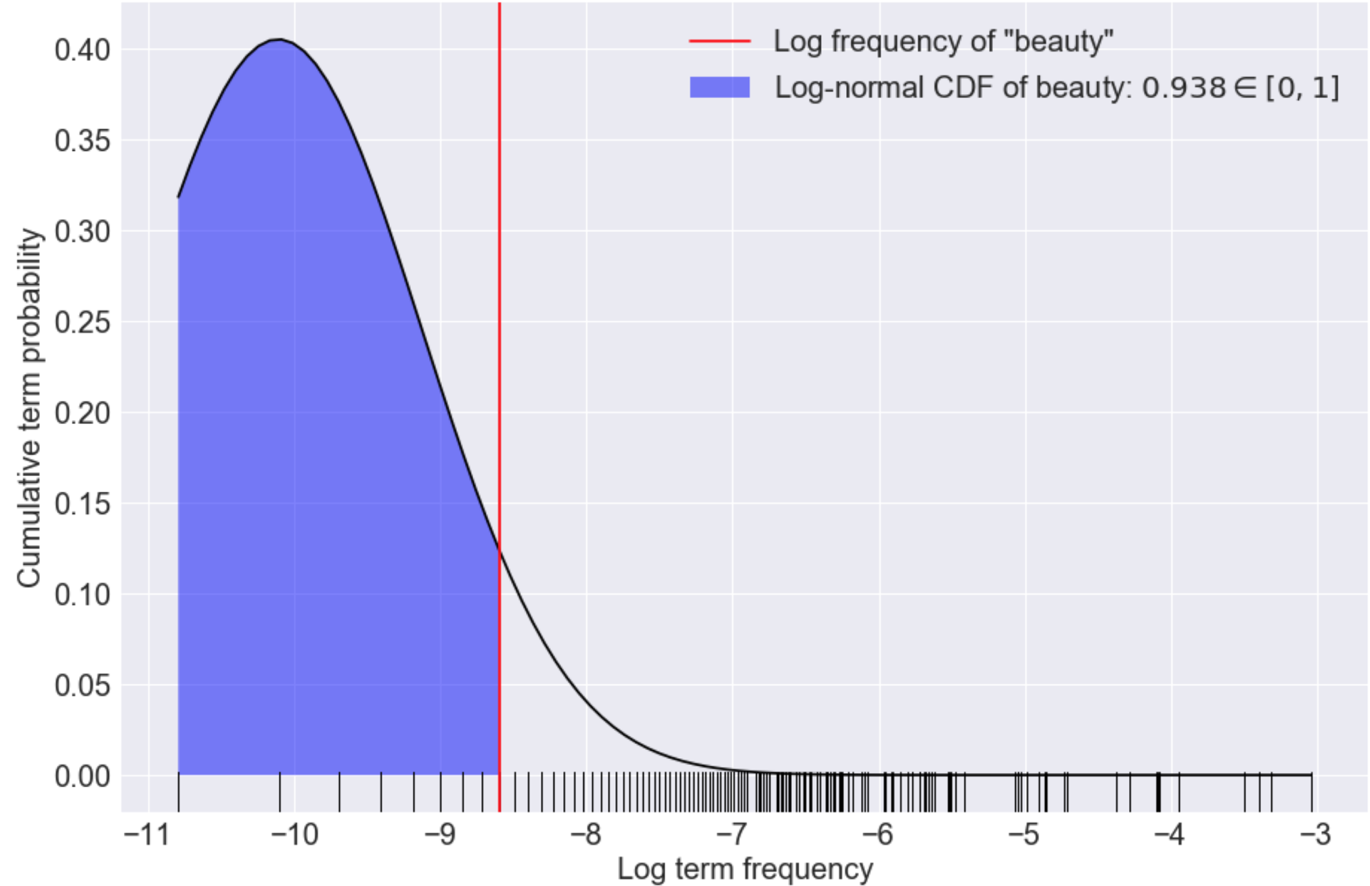
Fix: Normalize Precision and Frequency
Task: make precision and frequency similarly distributed
How: take normal CDF of each term’s precision and frequency
Mean and std. computed from data
Right: log normal CDF
This area is the log-normal CDF of the term “beauty” (0.938 ∈ [0,1]).
Each tick mark is the log-frequency of a term.
*log-normal CDF isn’t used in these charts
@jasonkessler

Slide 15
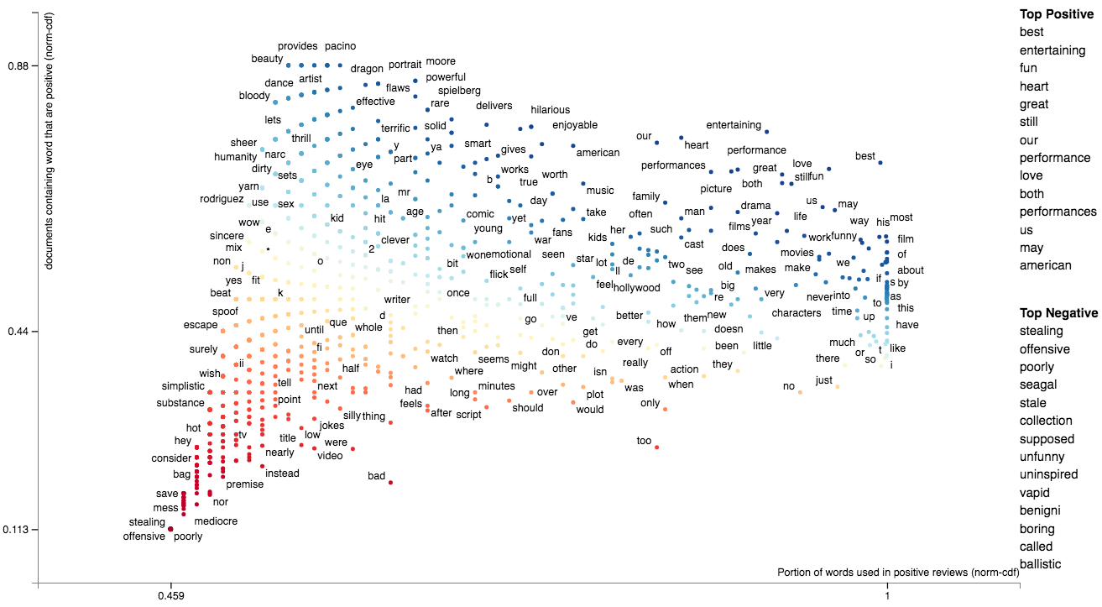
Scaled-F-Score
NormCDF - Precision
NormCDF - Frequency
@jasonkessler

Slide 16
Positive Scaled-F-Score
Good: positive terms make sense! Still some function words, but that’s okay.
NormCDF - Precision
Note These frequent terms are all very close to 1 on the x-axis, but are ordered
NormCDF - Frequency
@jasonkessler

Slide 17
Top Scaled-F Score Terms
Note: normalized precision and frequency are on comparable scales, allowing for the harmonic mean to take both into account.
 | Pos Freq. | Neg Freq. | Prec. | Freq % | Raw Hmean | Prec. CDF | Freq. CDF | Scaled F-Score
best | 108 | 36 | 75.00% | 0.22% | 0.44% | 71.95% | 99.50% | 83.51%
entertaining | 58 | 13 | 81.69% | 0.12% | 0.24% | 77.07% | 90.94% | 83.43%
fun | 73 | 26 | 73.74% | 0.15% | 0.30% | 70.92% | 95.63% | 81.44%
heart | 45 | 11 | 80.36% | 0.09% | 0.18% | 76.09% | 84.49% | 80.07%

Slide 18
Solution:
Compute Scaled F-Score association scores for negative reviews.
Use the highest score
NormCDF - Precision
Problem: highly negative terms are all low frequency
NormCDF - Frequency
@jasonkessler

Slide 19
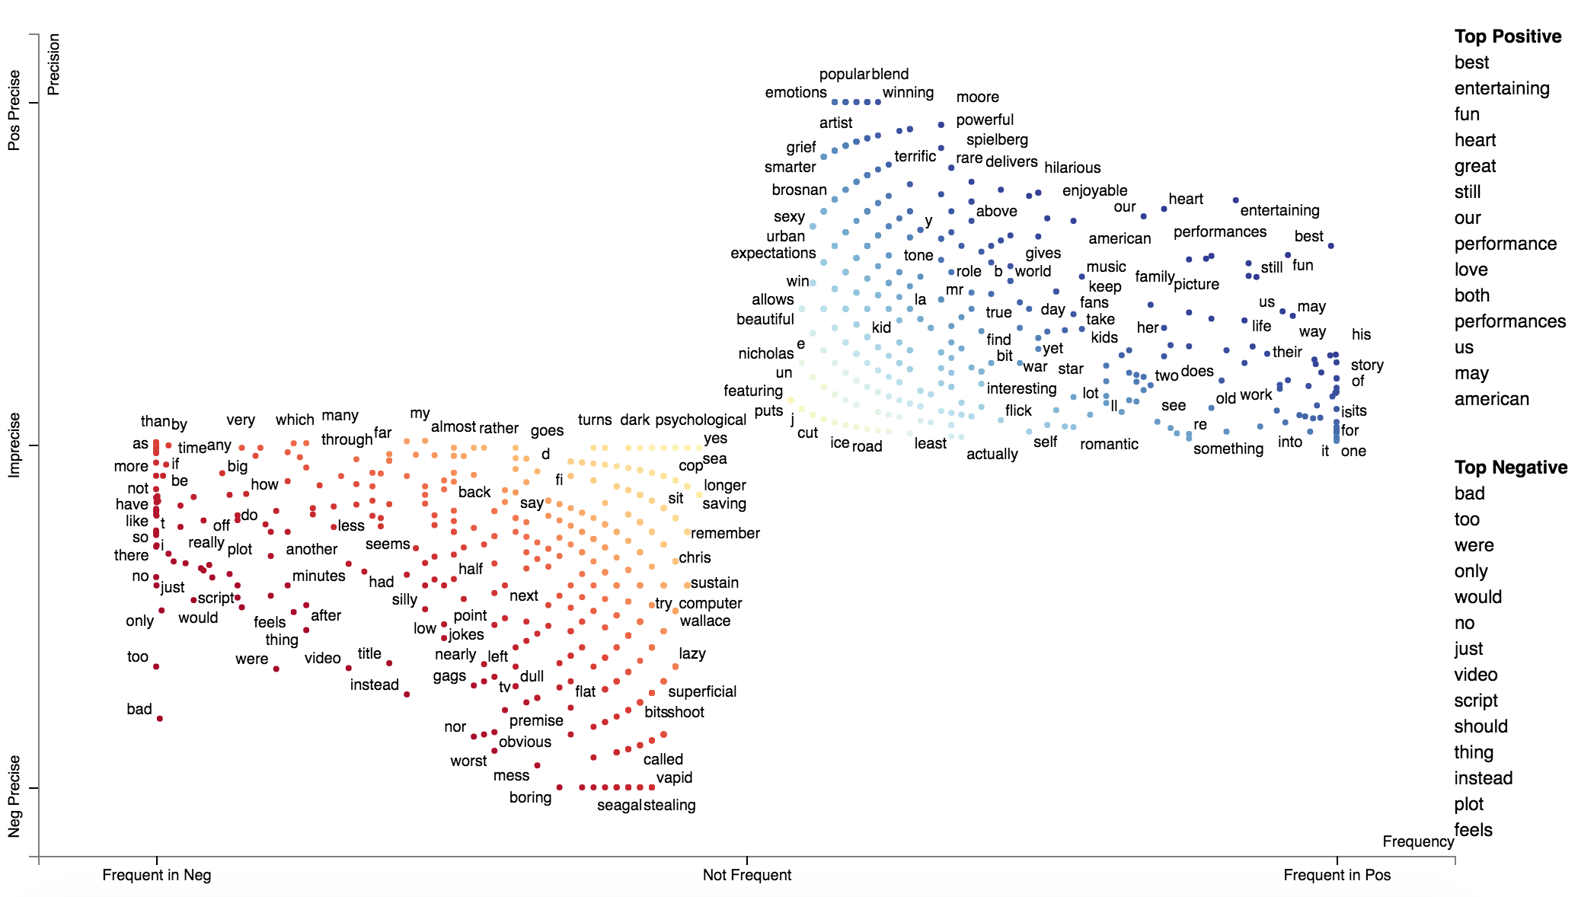
Scaled-F-Score
Positive Scaled F-Score
Note: only one obviously negative term
Negative Scaled F-Score
@jasonkessler

Slide 20
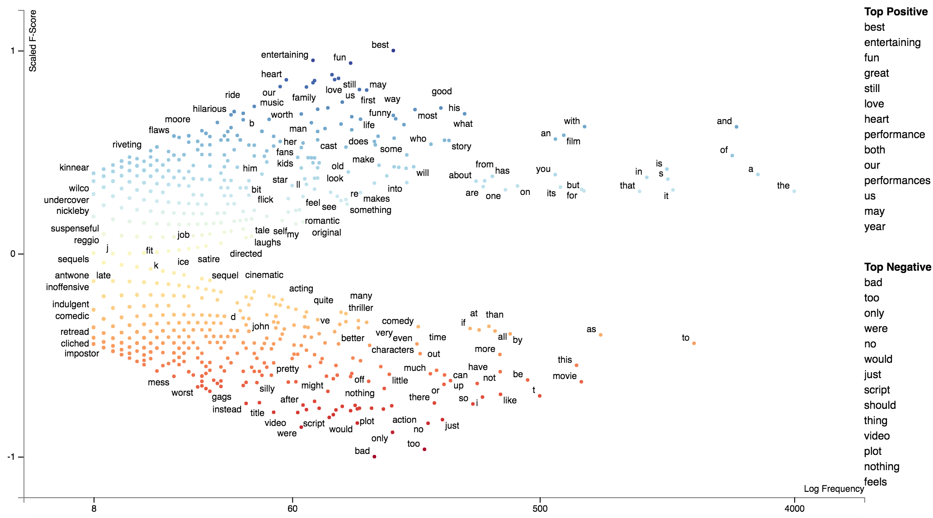
Scaled-F-Score by log-frequency
Scaled F- Score
The score can be overly sensitive to very frequent terms, but still doesn’t score them very highly
Log Frequency
@jasonkessler

Slide 21
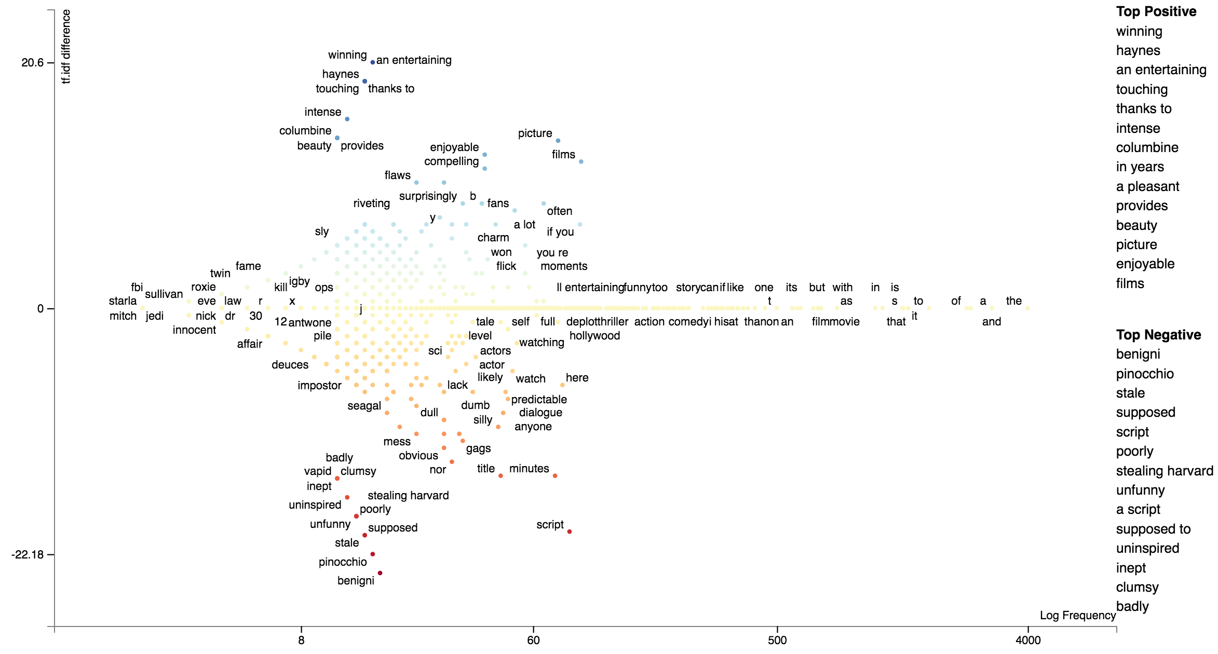
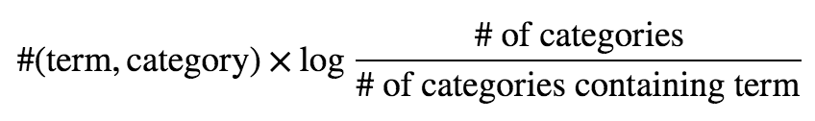
Why not use TF-IDF?
Drastically favors low frequency terms
term in all classes -> idf=1 -> score=0
TF-IDF(Positive) - TF-IDF(Negative)
TF
IDF
Log Frequency

Slide 22
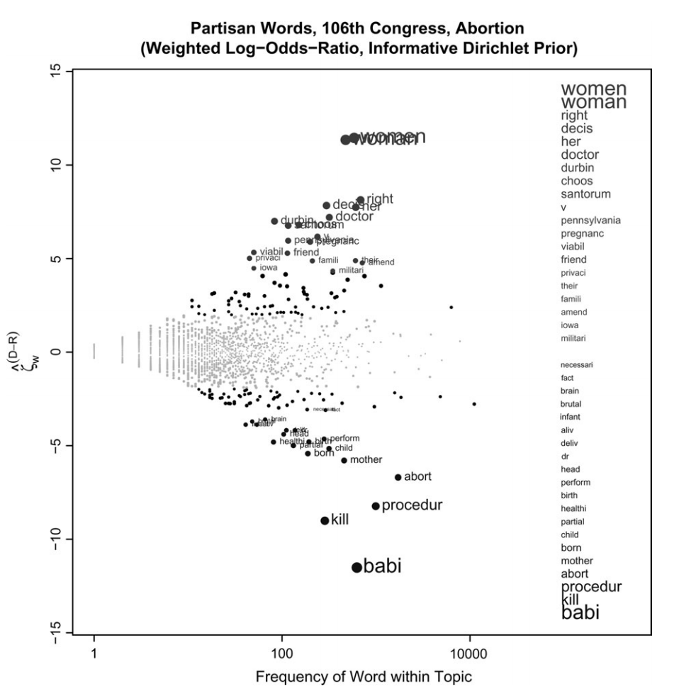
Monroe et. al (2009) approach
Bayesian approach to term-association
Likelihood: Z-score of log-odds-ratio
Prior: Term frequency in a background corpus
Posterior: Z-score of log-odds-ratio with background counts as smoothing values
Popular, but much more tweaking to get to work than Scaled F Score.
Burt Monroe, Michael Colaresi and Kevin Quinn. Fightin' words: Lexical feature selection and evaluation for identifying the content of political conflict. Political Analysis. 2008.
@jasonkessler

Slide 23
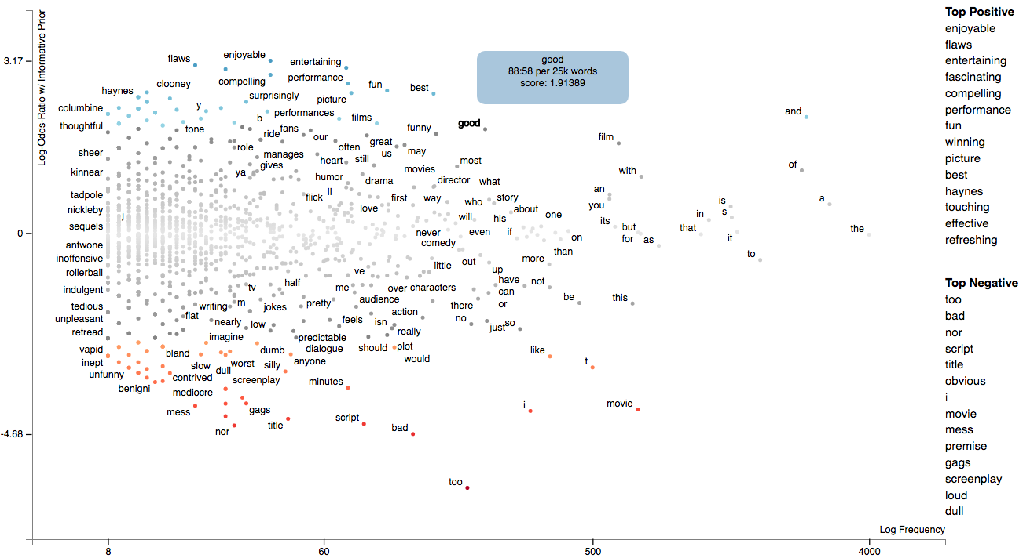
Scattertext implementation (with prior weighting modifications)
Scattertext reimplementation of Monroe et al. See
http://nbviewer.jupyter.org/github/JasonKessler/PuPPyTalk/blob/master/notebooks/Class-Association-Scores.ipynb for code.
@jasonkessler

Slide 24
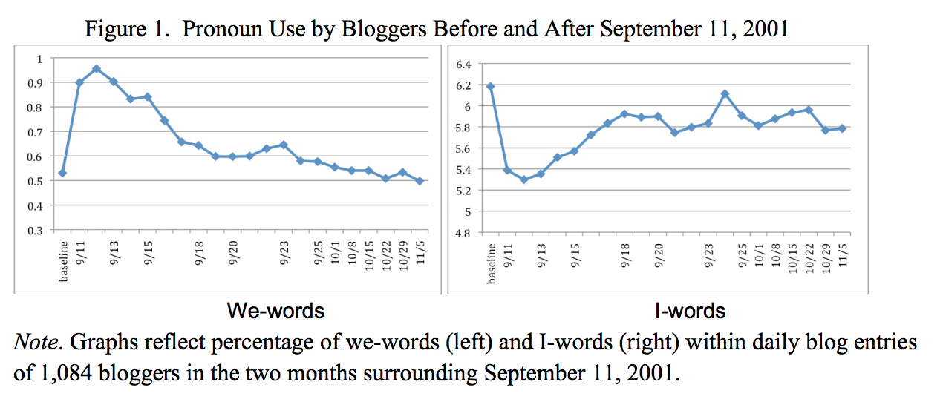
In defense of stop words
@jasonkessler
In times of shared crisis, “we” use increases, while “I” use decreases.
I/we: age, social integration
I: lying, social rank
Cindy K. Chung and James W. Pennebaker. Counting Little Words in Big Data: The Psychology of Communities, Culture, and History. EASP. 2012

Slide 25
Function words and gender
@jasonkessler
Performed on a variety of language categories, including speech.
Other studies have found that function words are the best predictors of gender.
LIWC Dimension Bold: entirely stop words | Effect Size (Cohen’s d) (>0 F, <0 M) MANOVA p<.001
All Pronouns (esp. 3rd person) | 0.36
Present tense verbs (walk, is, be) | 0.18
Feeling (touch, hold, feel) | 0.17
Certainty (always, never) | 0.14
Word count | NS
Numbers | -0.15
Prepositions | -0.17
Words >6 letters | -0.24
Swear words | -0.22
Articles | -0.24
Newman, ML; Groom, CJ; Handelman LD, Pennebaker, JW. Gender Differences in Language Use: An Analysis of 14,000 Text Samples. 2008.

Slide 26
Function word usage is counter-intuitive
@jasonkessler
Pennebaker et al:
Testosterone levels (in two therapeutic settings) predict:
Modest but significant decreases in:
Pronouns referring to others (ex: we, she, they)
Communication verbs (ex: hear, say)
Modest but significant decreases in:
Optimism words (ex: energy, upbeat)
Negative (but statistically insignificant) correlation with subject’s beliefs about testosterone and category usage!
Does not entirely explain gender differences.
Herring et al:
Subjects tasked with impersonating opposite gender in online game
Discussed stereotypical topics (cars, shopping) but didn’t change stylistic cues
James W. Pennebaker, Carla J. Groom, Daniel Loew, James M. Dabbs. Testosterone as a Social Inhibitor: Two Case Studies of the Effect of Testosterone Treatment on Language. 2004.
Susan C. Herring, Anna Martinson. Assessing Gender Authenticity in Computer-Mediated Language Use: Evidence From an Identity Game. Journal of Language and Social Psychology. 2004.
Notes:
No link to aggression, achievement, sexual behavior, anger, or markers of cognitive complexity.

Slide 27

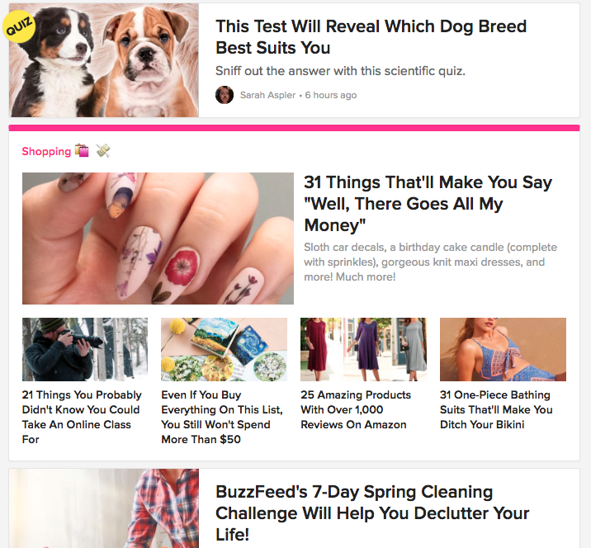
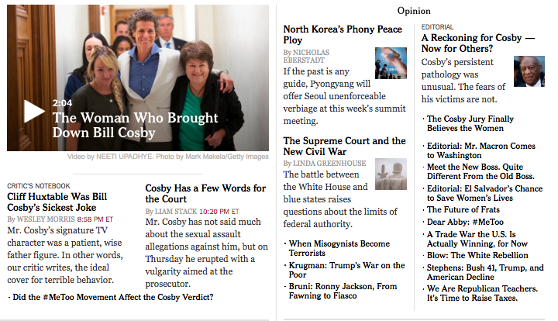
Clickbait: what works?
@jasonkessler

Slide 28
Clickbait corpus
@jasonkessler
Facebook posts from BuzzFeed, NY Times, etc/ from 2010s.
Includes headline and the number of Facebook likes
Scraped by researcher Max Woolf at github.com/minimaxir/clickbait-cluster.
We’ll separate articles from 2016 into the upper third and lower third of likes.
Identify words and phrases that predict likes.
Begin with noun phrases identified from Phrase Machine (Handler et al. 2016)
Filter out redundant NPs.
Abram Handler, Matt Denny, Hanna Wallach, and Brendan O'Connor. Bag of what? Simple noun phrase extraction for corpus analysis. NLP+CSS Workshop at EMNLP 2016.

Slide 29
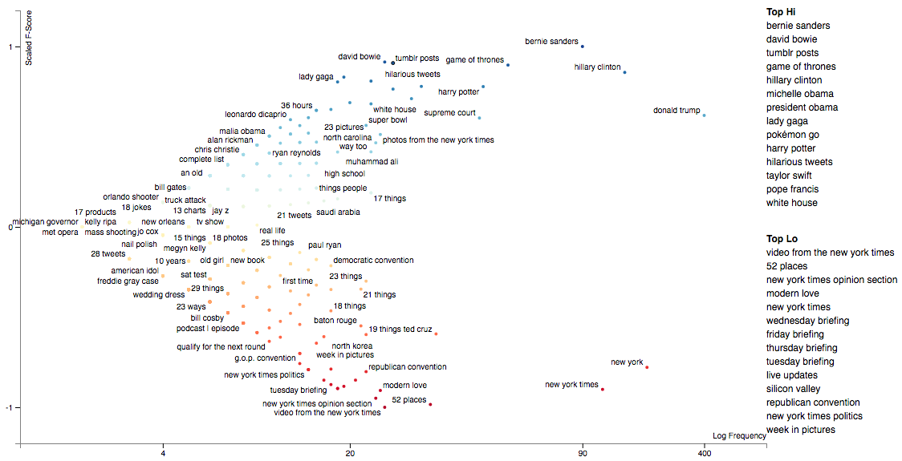
Scaled-F-Score of engagement by noun phrase
@jasonkessler

Slide 30
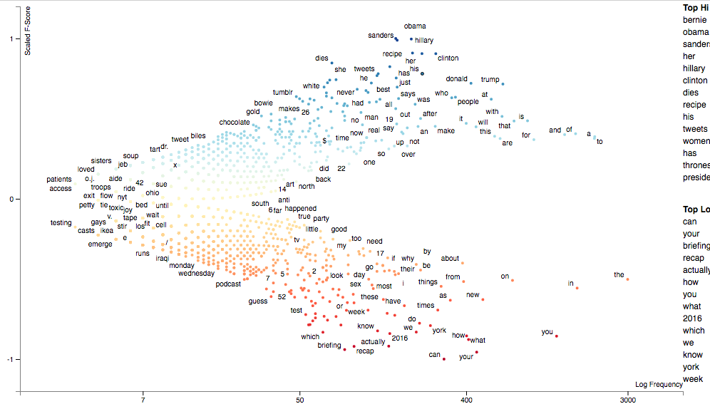
Scaled-F-Score of engagement by unigram
Messier, but psycholinguist information: 3rd person pronouns -> high engagement; 2nd person low
“dies”: obit
Can, guess, how: questions.
@jasonkessler

Slide 31
Clickbait corpus
@jasonkessler
How do terms with similar meanings differ in terms of their engagement rates?
Use Gensim (https://radimrehurek.com/gensim/) to find word embeddings
Use UMAP (McInnes and Healy 2018) to project them into two dimensions, and explore them with Scattertext.
Locally groups words with similar embeddings together.
Better alternative to T-SNE; allows for cosine instead of Euclidean distance criteria
Leland McInnes, John Healy. UMAP: Uniform Manifold Approximation and Projection for Dimension Reduction. Arxiv. 2018.

Slide 32
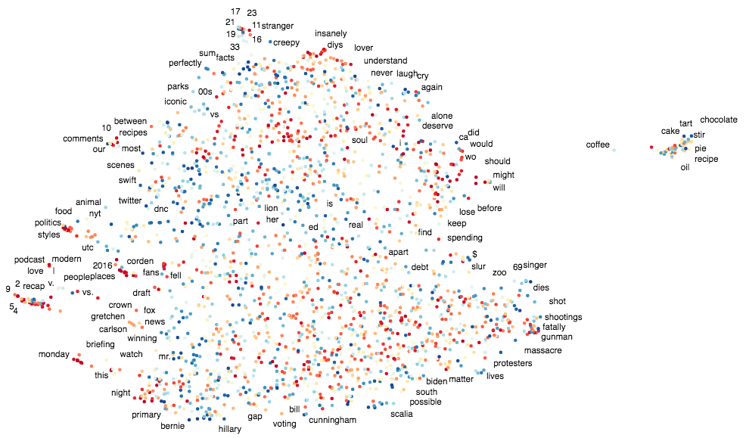
Term positions from determined by UMAP, color by Scaled F-Score for engagement.
This island is mostly food related. “Chocolate” and “cake” are highly engaging, but “breakfast” has predictive of low engagement.
@jasonkessler

Slide 33
Clickbait corpus
@jasonkessler
How do the Times and Buzzfeed differ in what they talk about, and their content engages their readers?
Scattertext can easily create visualizations to help answer these questions.
First, we’ll look at how what engages for Buzzfeed contrasts with what engages for the Times, and vice versa
Leland McInnes, John Healy. UMAP: Uniform Manifold Approximation and Projection for Dimension Reduction. Arxiv. 2018.

Slide 34
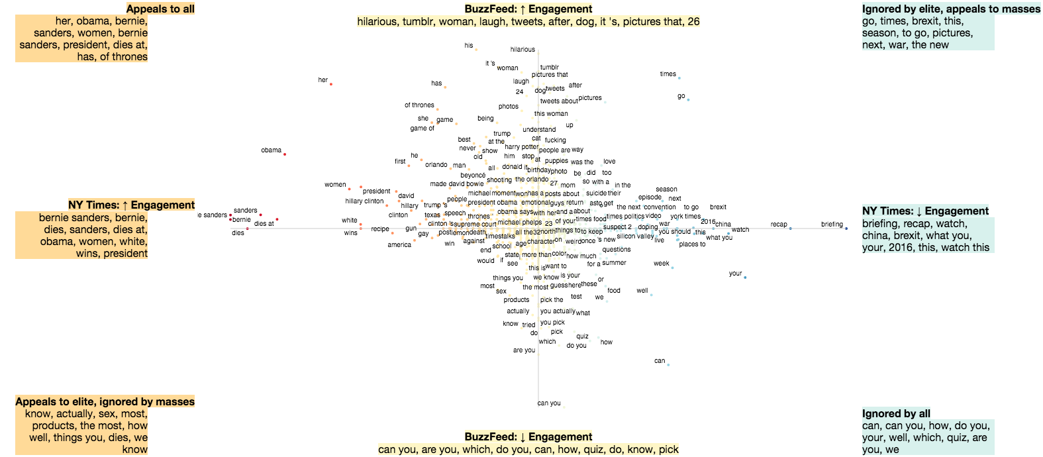
@jasonkessler
This chart doesn’t give a good sense of what language is more associated with one site.
Oddly, NY Times readers distinctly like articles about sex, death, and which are written in a smug tone.

Slide 35
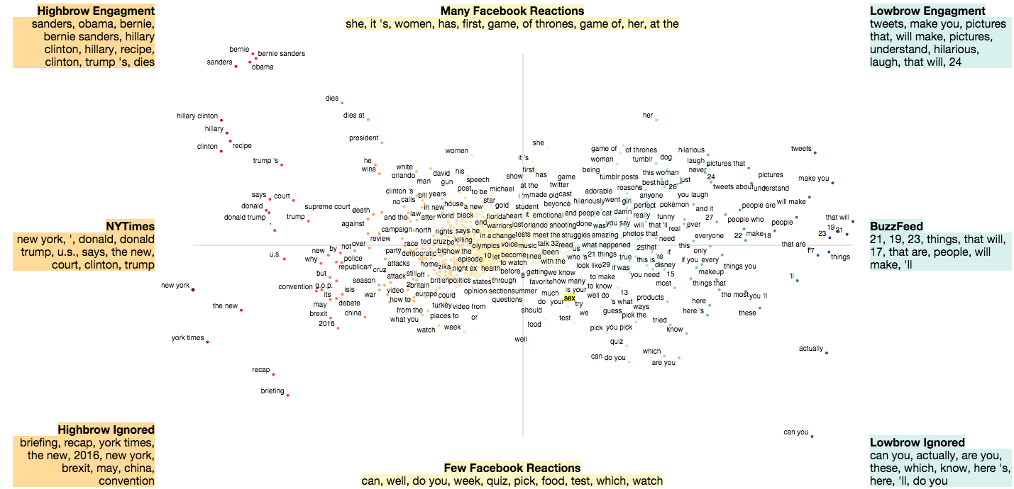
@jasonkessler
This chart let’s you know how Buzzfeed and the Times are distinct, while still distinguishing engaging content,

Slide 36
Thank you! Questions?
@jasonkessler
Jason S. Kessler
Global AI Conference
April 27, 2018
https://github.com/JasonKessler/GlobalAI2018

